Slide 1
Case study title
Abhishek sharma

Slide 2
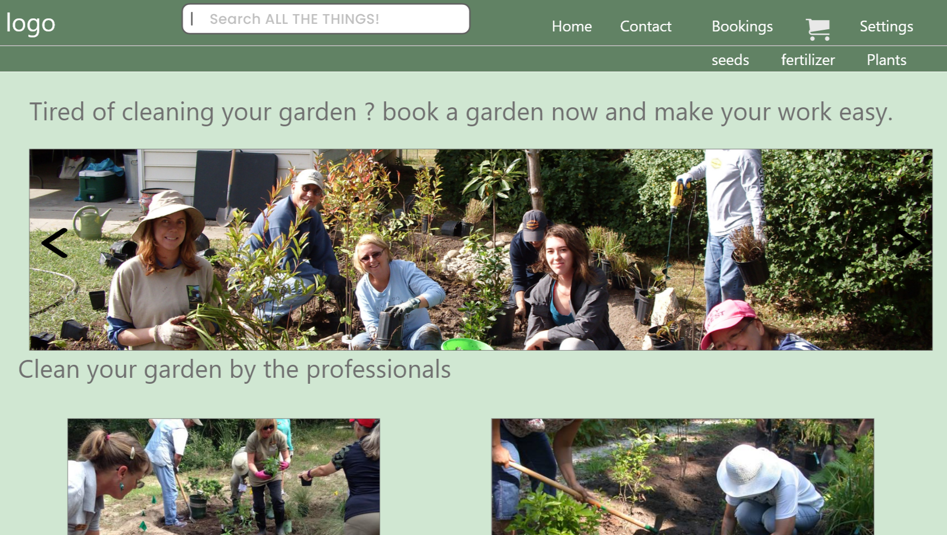
Project overview
The product:
This project is focused on providing garnder on catract for cleaning purpose.
Preview of selected polished designs.
Project duration:
It took 1week to design the website.

Slide 3
Project overview
The problem:
Availability of professional gardner.
The goal:
Provide gardner hastle free.
Provide gardner on demand.

Slide 4
Project overview
My role:
Ux designer
Responsibilities:
Wireframing , prototyping, product

Slide 5
User research
Personas
Problem statements
Understanding
the user

Slide 6
User research: summary
I conducted interviews and created empathy maps to understand the users I’m designing for and their needs. A primary user group identified through research was working adults who don’t have time to clean their garden
Unmoderated research study is conduced and assumed that user can navigate between different tabs easily.

Slide 7
User research: pain points
1
2
3
Pain point
Pain point
Pain point
Difficulty in finding confirmation option.
Availability of various payment option
Difficulty in fiding the charges of gardner

Slide 8
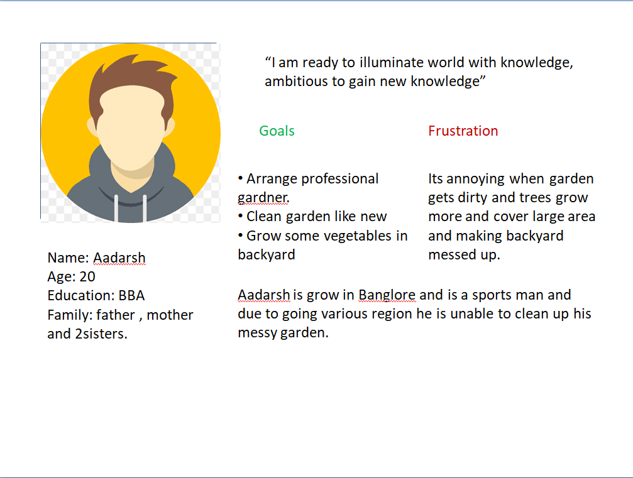
Persona: Name
Problem statement:
Aadarsh is a sports man
who needs gardner
Because he is out of own frequently and is unable to clean its garden.

Slide 9
Paper wireframes
Digital wireframes
Low-fidelity prototype
Starting
the design

Slide 10
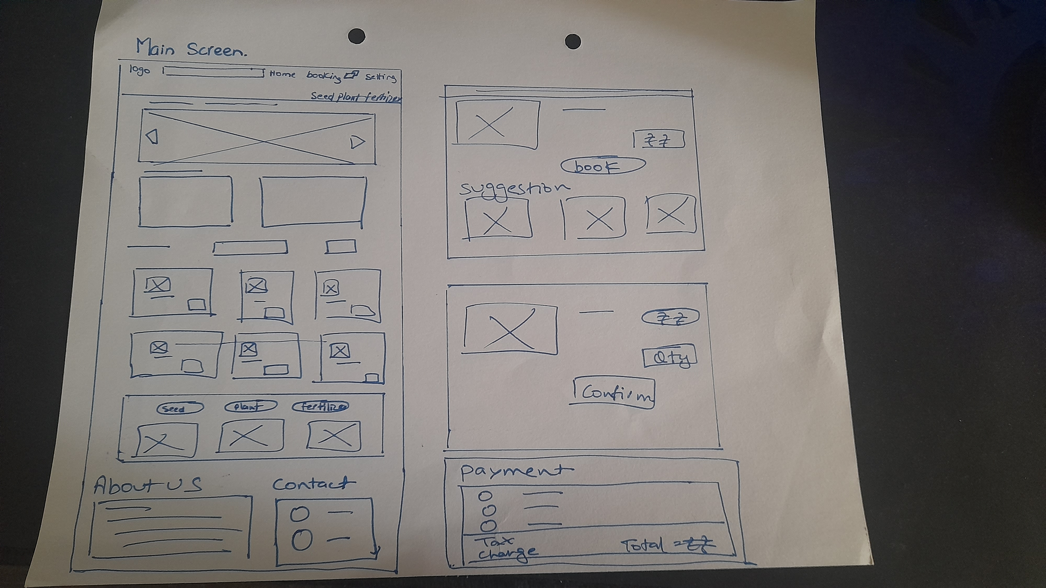
Paper wireframes

Slide 11
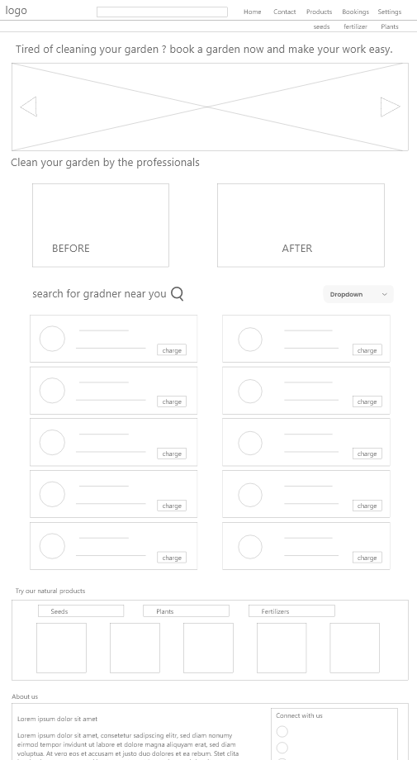
Digital wireframes
Showing the pictures of gardners working.
Book gardner more effectively and save time.
Showing the available gardner in near area.

Slide 12
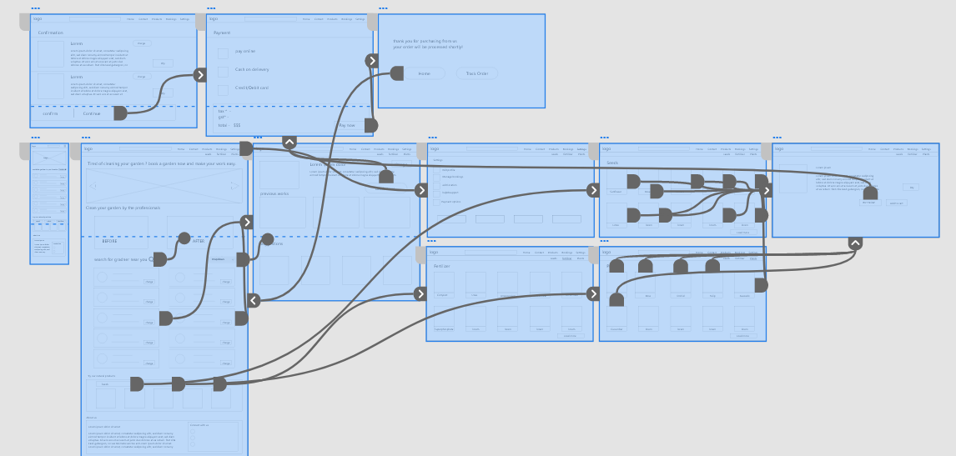
Link
Low-fidelity prototype
https://xd.adobe.com/view/2718dc31-2b19-48d9-ae1d-2da41d3b84b1-724b/

Slide 13
Refining
the design
Mockups
High-fidelity prototype
Accessibility

Slide 14
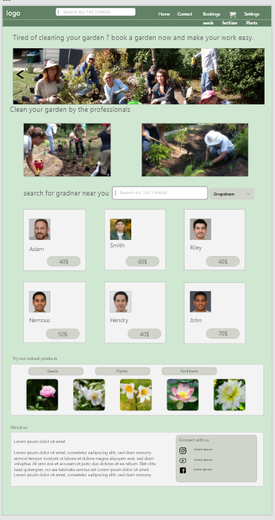
Mockups
Before usability study
After usability study
Changing the available gardner to make easily accesible.

Slide 15
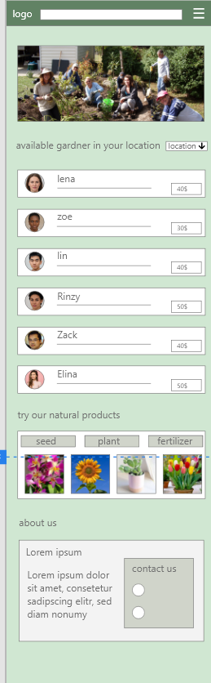
Mockups
window
Mobile

Slide 16
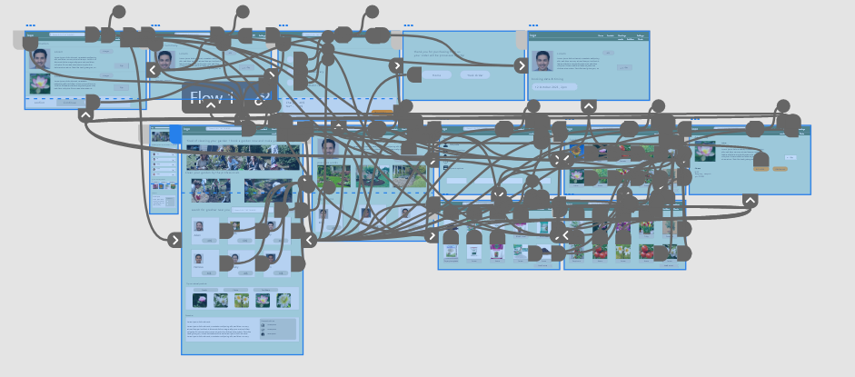
High-fidelity prototype
Screenshot of prototype with connections or prototype GIF

Slide 17
Accessibility considerations
1
2
3
Provided access to users who are vision impaired through adding alt text to images for screen readers.
Used icons to help make navigation easier.
Used image of worker to identify the worker.

Slide 18
Going forward
Takeaways

Slide 19
Takeaways
Impact:
Helps the people to find a professional gardner for themselve for their dirty garden. Even from out of town.
While designing the Gardner app, I learned that the first ideas for the app are only the beginning of the process. Usability studies and peer feedback influenced each iteration of the app’s designs.

Slide 20
Let’s connect!
Thank you for your time reviewing my work on the Gardner app! If you’d like to see more or get in touch, my contact information is provided below.
Email: abhisheksh0012@gmail.com

Slide 21
Thank you!

